Slide 1

Pitch 2
Virtual Hawk - Team 3

Slide 2
Problem Statement
You are new to the campus or want to know what events are happening around campus.
Our solution is Virtual Hawk!

Slide 3
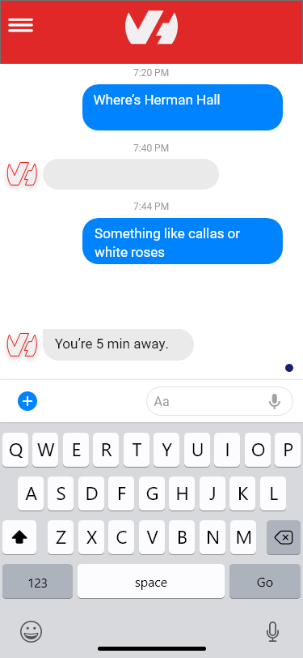
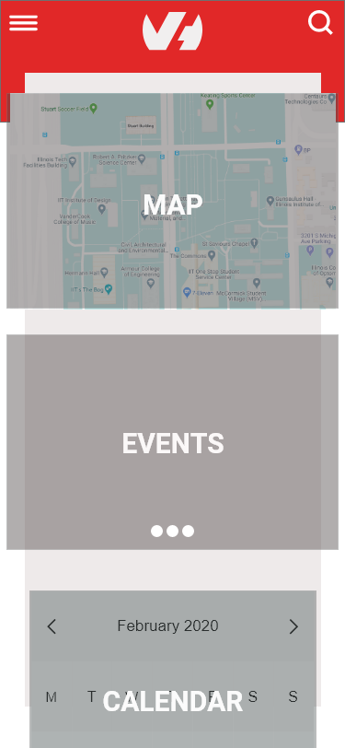

Slide 4
Problem One: Privacy and Security
How do we keep things secure?
Our solution would be to make a user registry. Doing this will allow us to keep data on who is using the website. Along with that we can gather data on what people are doing on the campus and why they are there.

Slide 5
Problem two: Custom Maps
How can we create a simpler user experience?
The way we can implement this is using free source map APIs. Some examples of this is Modest Maps and Leaflet. Google Maps is great resource and model on how we can make our map.

Slide 6
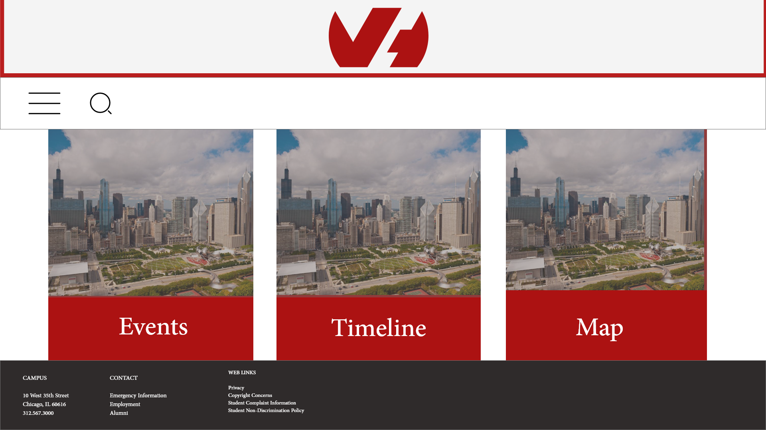
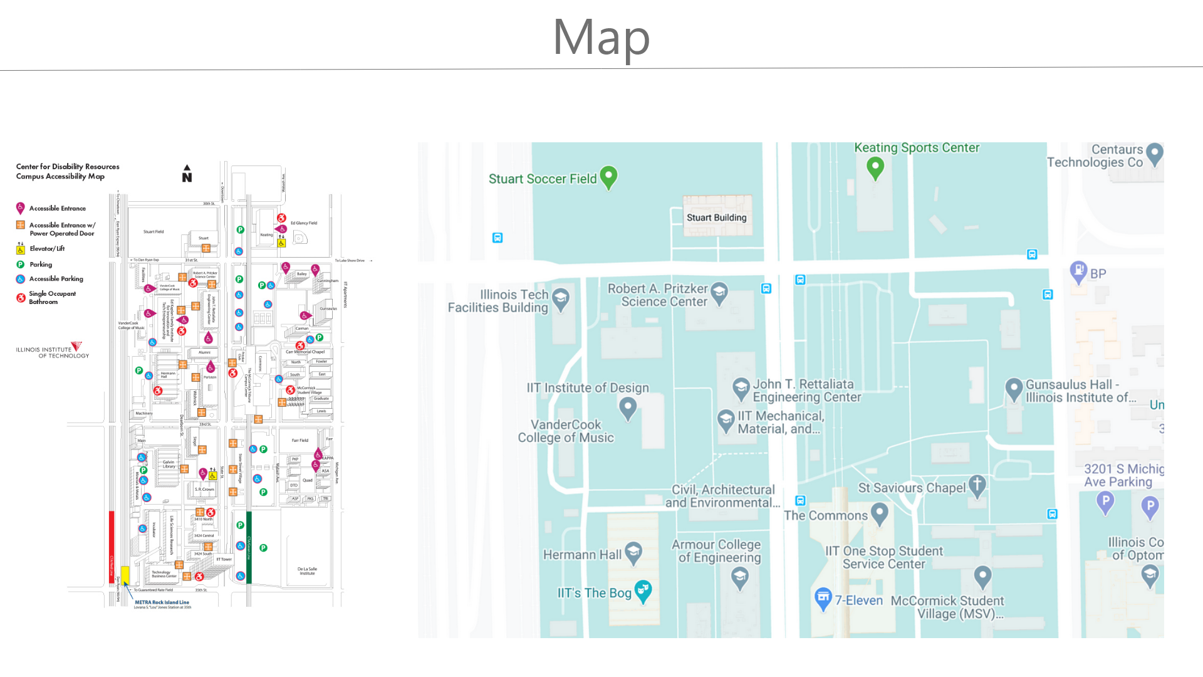
Map

Slide 7
Problem Three: Data Permissions
Can we use the students/ visitors data?
We will have to get permission from IIT in order to have the student data. After that we have to get the user permission with a popup on whether they want to sync their info. Then the students have to sign in with the IIT login if yes.

Slide 8
Problem Four: Live Updates
We will utilize React data polling and for live updates, we will be utilizing react JS hooks for live section updates.

Slide 9
Problem Five: Data Scraping
Problem five is grabbing existing data. For this, we will be using existing resources from OTS like api’s. MongoDB will be our database as well.
We will also have some python scripts to find new events.
Library websites will be pulled into our database server that we will create.

Slide 10
Conclusion
The goal is to increase connectivity within the Illinois Tech community, enhance on-campus student experience, and increase involvement and participation in clubs, events, and campus activities.

